Slide 1


Facial Recognition to Detect Mood and Recommend Songs

Slide 2
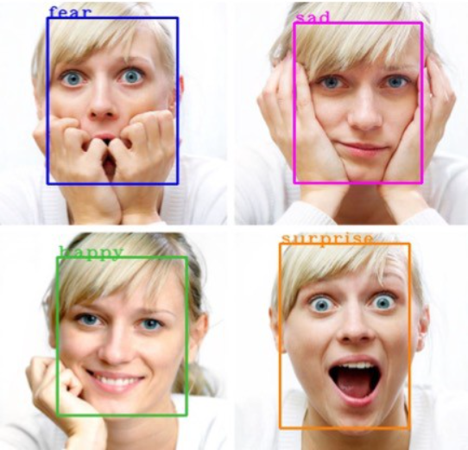
Introduction
Facial expressions are captured using an inbuilt camera. Feature extraction is performed on input face images to detect emotions such as happy, angry, sad, surprise, and neutral.
Automatically music playlist is generated by identifying the current emotion of the user.

Slide 3
Dataset
Dataset is collected from Kaggle.
The data consists of 48x48 pixel grayscale images of faces. The faces have been automatically registered so that the face is more or less centred and occupies about the same amount of space in each image.
In dataset many images like 7 emotions like angry, disgust, fear, happy, neutral, surprise, sad.

Slide 4
Methodology
'
1. Import the libraries
2. Divide the dataset to train and test
3. building CNN model
4. Normalize the data
5. compiling CNN model –(loss function I used is categorical crossentropy,
Activation function I used is relu and I got accuracy is 80%)
6.Building UI

Slide 5
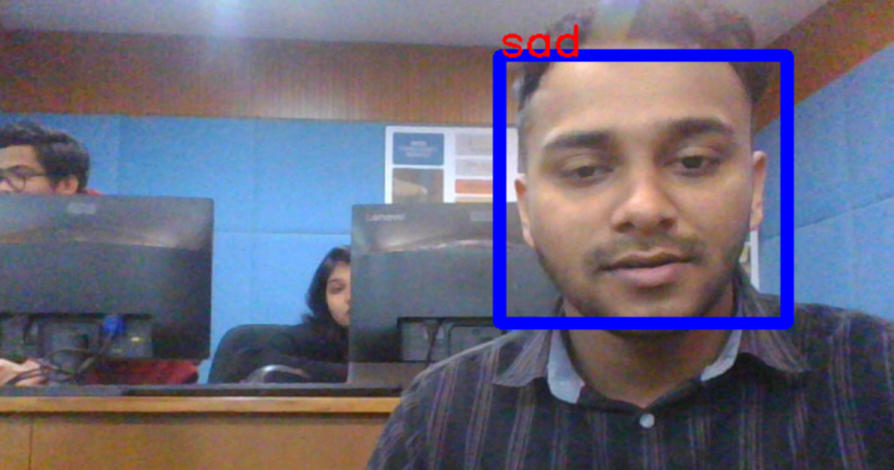
User Interface

Slide 6
Thank you
Tony Tomy
21BDA44

